Slide 1
THE PROGRESSIVE ERA Standard: 11.2.4 Students understand the effects of political programs and activities of the progressives.

Slide 2
The Changing Face of Industrialism
Industrial growth means more goods at lower prices
Residue of social problems from 1890s
New century begins on optimistic note

Slide 3
The Innovative Model T
Henry Ford transforms auto industry with mass production and standardized parts
Small profit on each unit, grosses huge profit due to high volume of sales
1908--Model T introduced
1916--Federal government begins highway subsidies ( build roads for the new cars)

Slide 4
The Burgeoning Trusts
The trend toward bigness in industry accelerates after 1900
Bankers provide integrated control through interlocking directorates
Trusts are controversial
often denounced as threats to equality
some defend them as more efficient

Slide 5
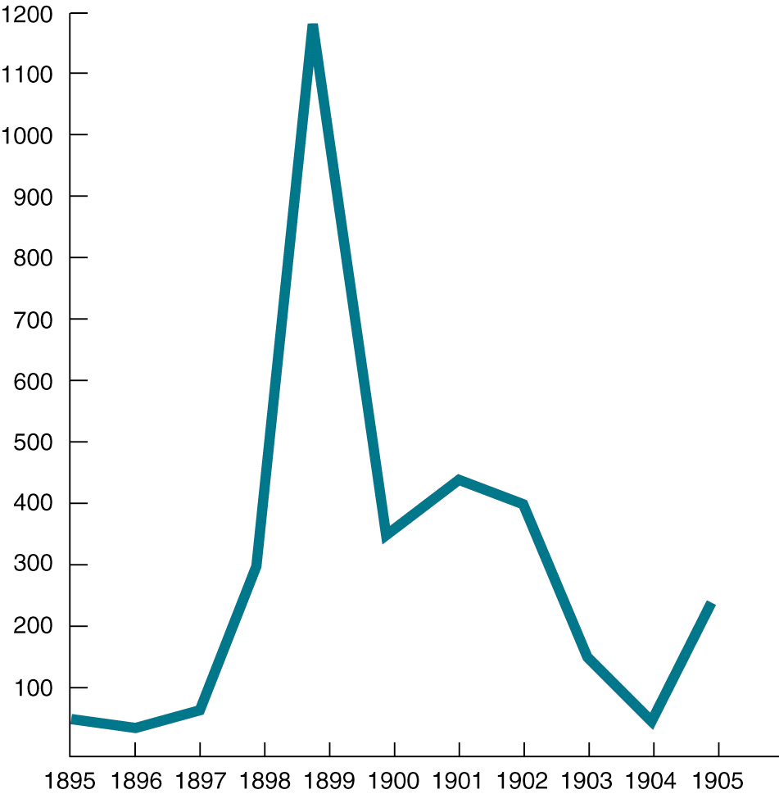
Business Consolidations (mergers), 1895-1905

Slide 6
Managing the Machines
Frederick Taylor advocates “Scientific Management” to increase efficiency
Worker welfare, morale suffers
better paychecks
increased danger, tedium work

Slide 7
Society's Masses
Employment expands rapidly to increase production
Women, immigrants, blacks, Mexican Americans enter work force

Slide 8
Better Times on the Farm
Isolation reduced by mail and parcel post deliveries to farms
Tenant farmers (mostly in the South) remain impoverished
Western farmers benefit from vast irrigation projects

Slide 9
Women and Children at Work
Women resist ideals of domesticity to enter work force
Women’s labor unions defend rights of women, child laborers
1921--Congress passes laws protecting pregnant workers’, their infants’ health

Slide 10
The Niagara Movement and the NAACP
1905--W.E.B. DuBois, others reject accommodation to racist society
"Niagara Movement" demands immediate respect for equal rights of all
NAACP, Urban League, advocate African American rights
Black workers gain least from prosperity

Slide 11
"I Hear the Whistle": Immigrants in the Labor Force
1901-1920--fresh influx of Europeans, Mexicans, Asians to labor force
Non-English speakers considered a social problem
Programs to "Americanize" them
Immigration limited from China, Japan, Mexico, southern, central Europe

Slide 12
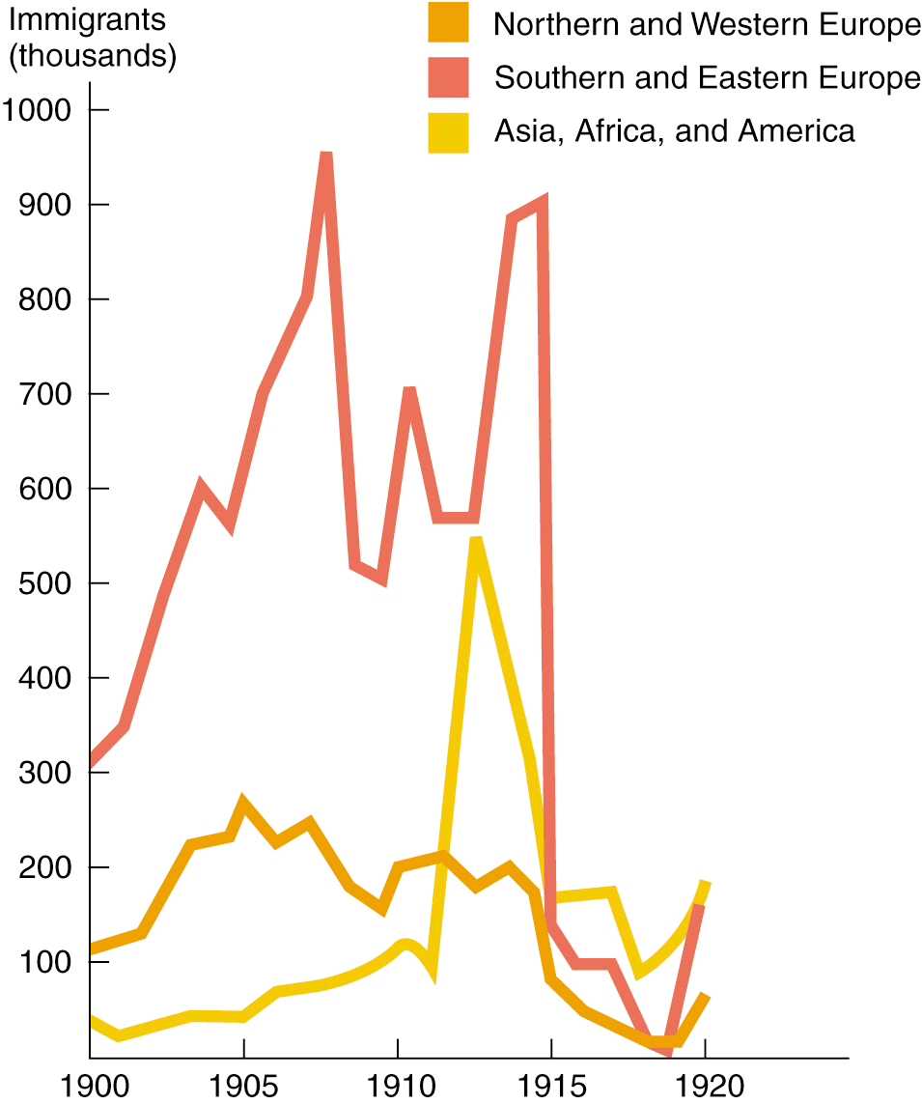
Immigration to the United States, 1900-1920 (by area of origin)

Slide 13
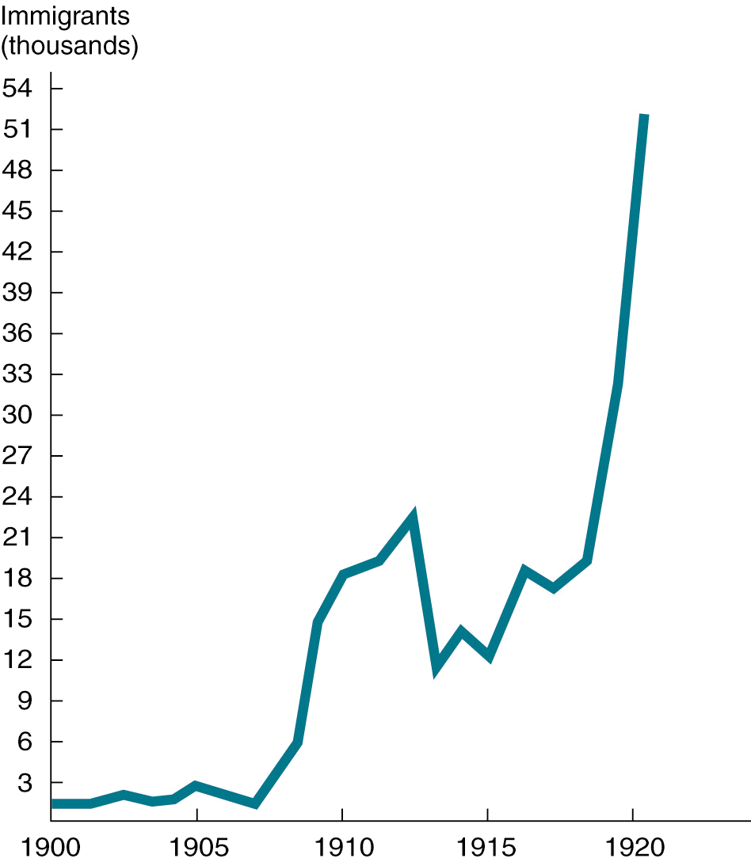
Mexican Immigration to the United States, 1900-1920

Slide 14
Conflict in the Workplace
1915-1918--new round of labor unrest
Industrial productivity falls
Union membership soars

Slide 15
Organizing Labor
A.F.L. the largest union
1903--women excluded from A.F.L. form Women's Trade Union League
1905--others excluded from A.F.L. form Industrial Workers of the World
Radical organizations win spectacular strikes with small numbers
Fears of class warfare increase

Slide 16
Labor Union Membership, 1897-1920

Slide 17
Working with Workers
Employers improve working conditions to avoid trouble
Henry Ford doubles wages, reduces workday
plant production increases
union activity ends ( partly due to his “security forces”)

Slide 18
Amoskeag
Amoskeag mills model paternalistic approach to labor management
Company hires whole families
Benefits include playgrounds, health care, home-buying plans, recreation areas, etc…

Slide 19
A New Urban Culture
Mass production means mass consumption
Most Americans experience abundance

Slide 20
Production and Consumption
1900-1920--new advertising techniques create demand for goods
Goods increase U.S. standard of living
Wealth increasingly concentrated

Slide 21
Living and Dying in an Urban Nation
By 1920 the average life span increased substantially
Booming cities take on modern form
Zoning regulations separate industrial, commercial, residential areas

Slide 22
Popular Pastimes
Ordinary people achieve leisure for first time in American history
Spectator pastimes include baseball, football, movies, concerts
Popular music--Sousa marches, ragtime, blues, jazz, vaudeville
Light reading includes romance, detective, science-fiction novels

Slide 23
Experimentation in the Arts
Dance--Isadora Duncan
Painting--Ashcan School, post-Impressionists
Poetry--T.S. Eliot and Ezra Pound

Slide 24
A Ferment of Discovery and Reform
Racism, labor conflict remain
Solid social and economic gains made
Optimism that social experiments can succeed

Slide 25
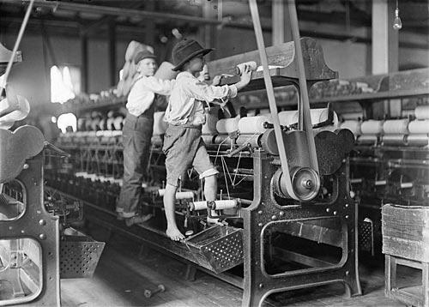
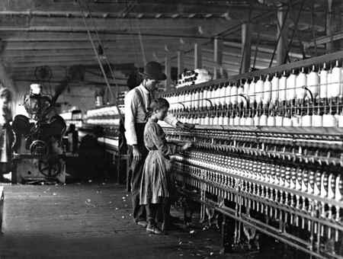
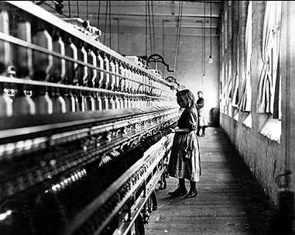
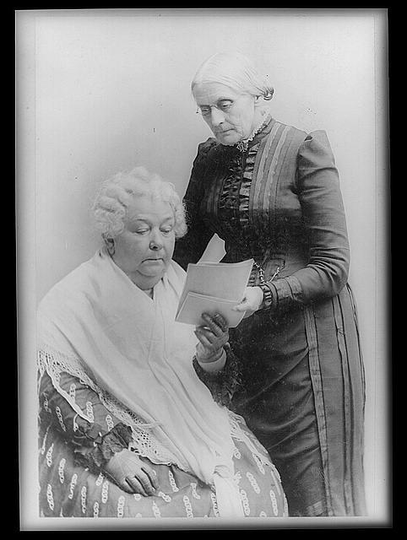
CAHSS Standard 11.2.9
Progressives

Slide 26
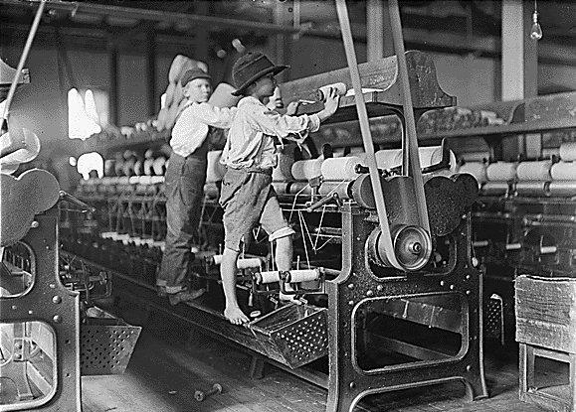
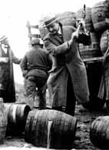
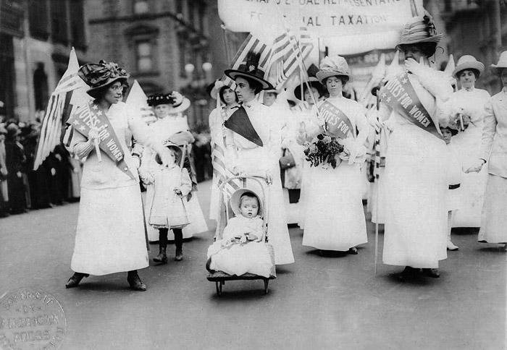
Progressives
Reformers- confronted problems of industrial/ urbanization
Predominantly middle class
Women played vital role
Initially local in scope→ Statewide→ National
Addressed labor & economic issues
Major Progressive Issues:
Child Labor
Prohibition
Women’s Suffrage

Slide 27
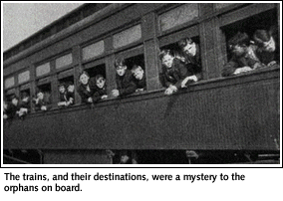

Slide 28
Orphan Trains
Industrialization created labor population unable to pay for the well being of children
Child homelessness plagued Northeastern US
100,000’s needed $, food, shelter
Estimated 30,000 homeless children in NYC in 1850s
Charles Loring Brace est. Children’s Aid Society
To address problem of child homelessness
Homeless children from industrial centers sent West by train to work on farms
1854- 1929 > 120,000 children taken
Forerunner for modern foster care
Children taken to 45 different states

Slide 29
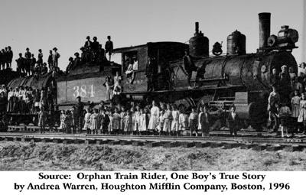
"The great duty, is to get utterly out of their surroundings and to send them away to kind Christian homes in the country." - Charles Loring Brace

Slide 30
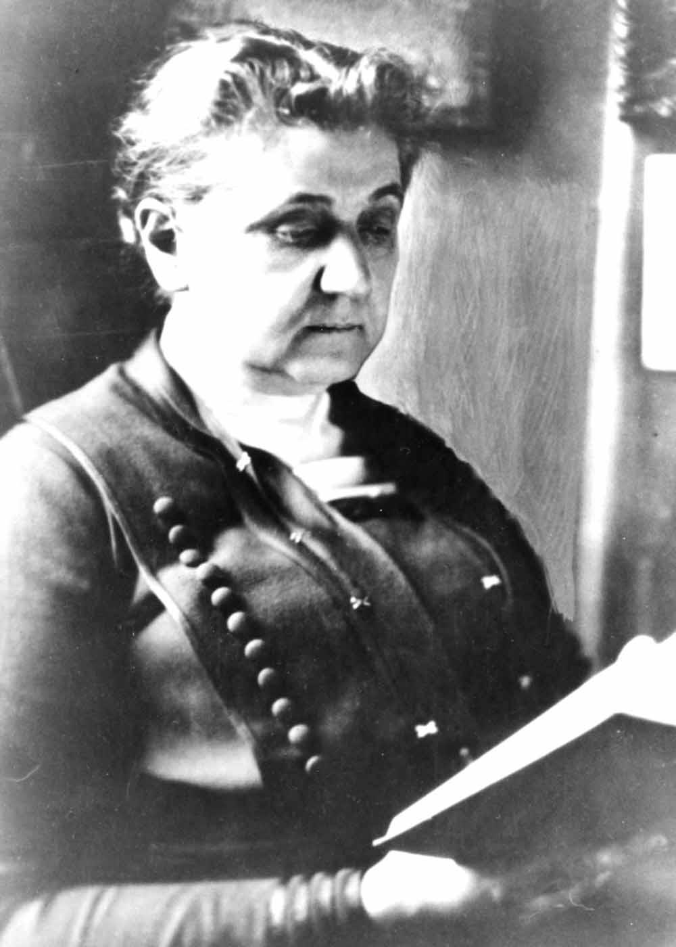
Jane Addams
Progressive- University educated, from wealthy family
Opened Hull House (1889)
Rented mansion
HQ for providing social services
Health services
Kindergarten
Youth clubs
Cultural festivities and shows

Slide 31
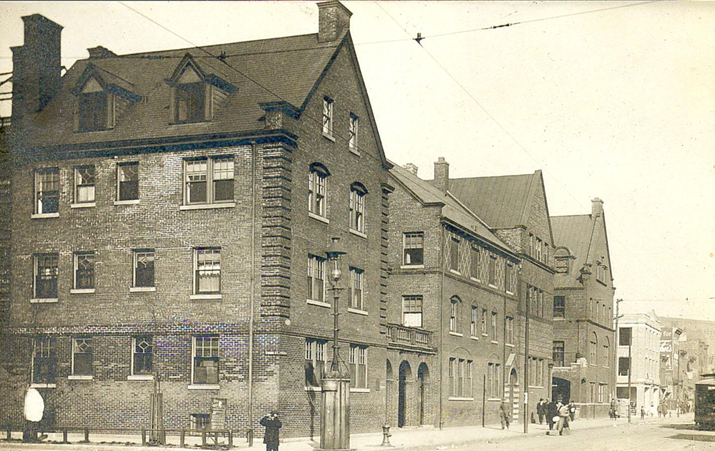
Hull House

Slide 32
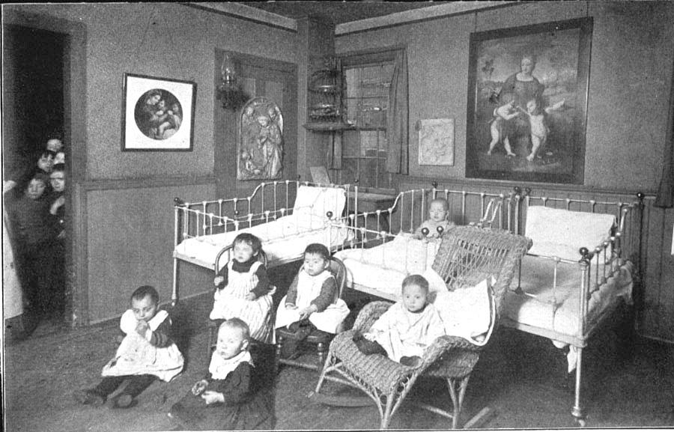
The nursery at Hull House

Slide 33
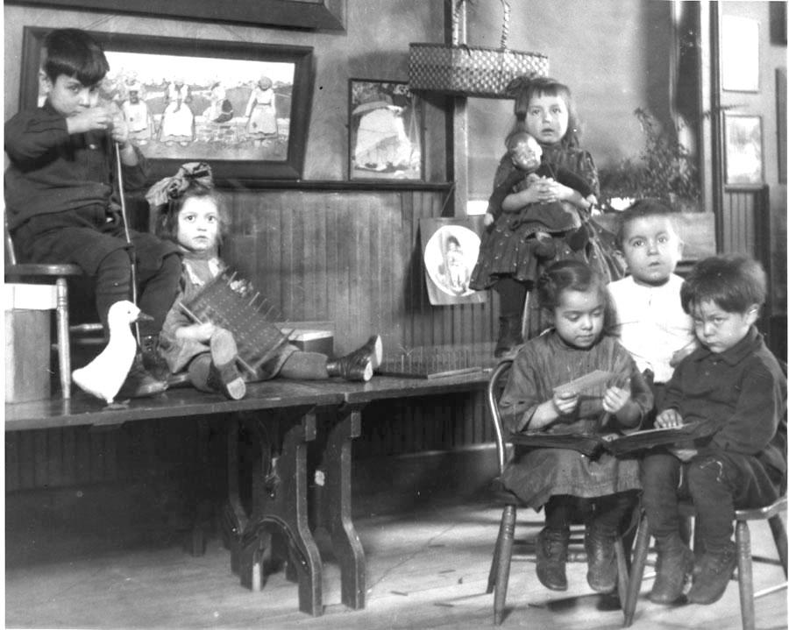

Slide 34
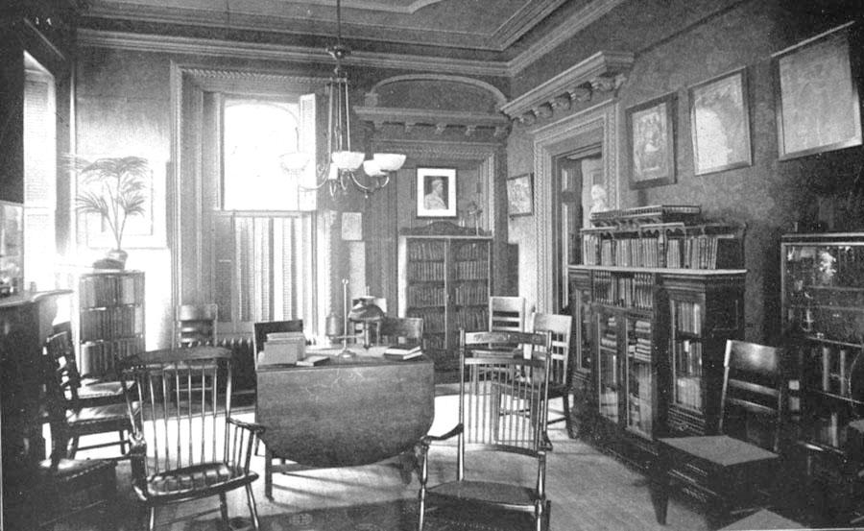
The library at Hull House

Slide 35
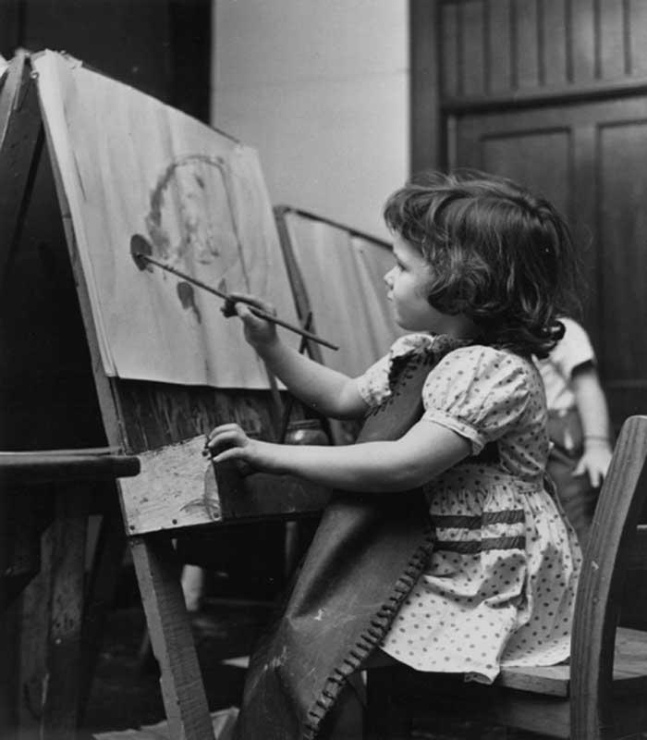
Social programs at Hull House benefited children and adults.

Slide 36
Women’s Suffrage
Suffrage- the right to vote
Movement began in the 1820’s
Elizabeth Cady Stanton & Lucretia Mott
1848- Organized Women’s Rights Convention (Seneca Falls, NY)
National Women’s Suffrage Association (NWSA)
Founded by Elizabeth Cady Stanton & Susan B. Anthony
American Women’s Suffrage Assoc. (AWSA)
Founded by Lucy Stone & Julia Ward Howe
19th Amendment- proposed June 4, 1919; Ratified August 18th 1920

Slide 37
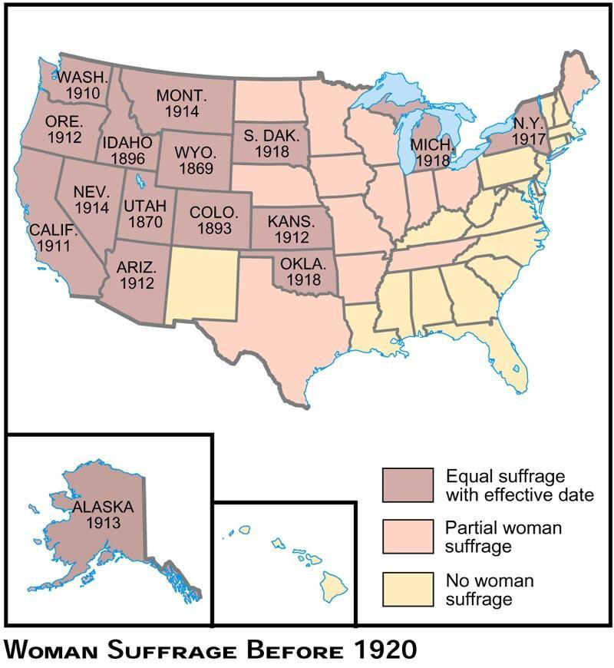

Slide 38
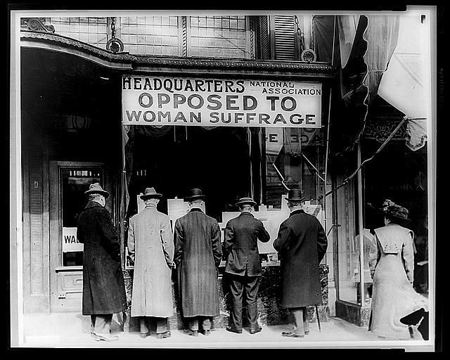

Slide 39
Suffrage Parade- women march to win right to vote New York City, 1912

Slide 40
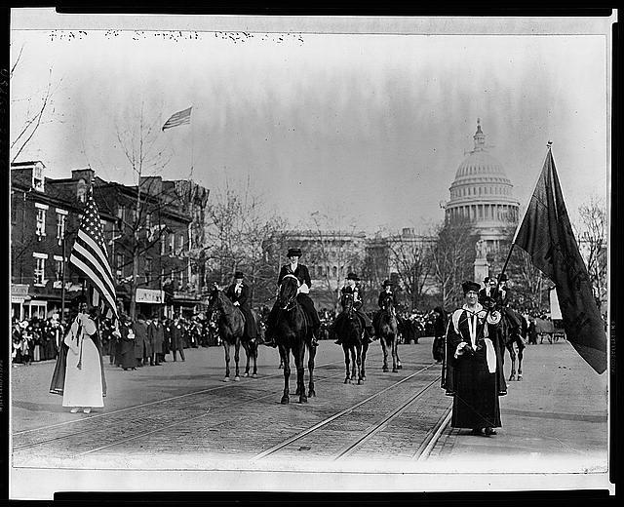
Suffrage Parade- women march to win right to vote Washington DC, 1913

Slide 41
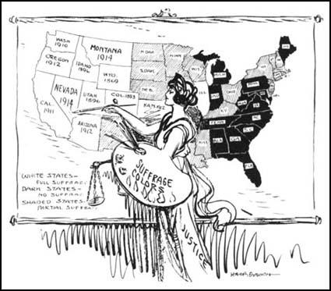

Slide 42
Fair Labor Standards Act
Passed 1938 (FDR)
Objective: “eliminate conditions detrimental to . . . Health, efficiency, and well-being of workers”
Minimum wage
1st year- 44 hr/wk @ 25 cents/hr
2nd year- 42 hr/wk @ 30 cents/hr
3rd year- 40 hr/wk @ 40 cents/hr
Child labor
Prohibited in inter-state food industries
Minimum employment age- 14 yr old outside of school hours
16 yr old during school hrs
18 yr for hazardous occupation

Slide 43
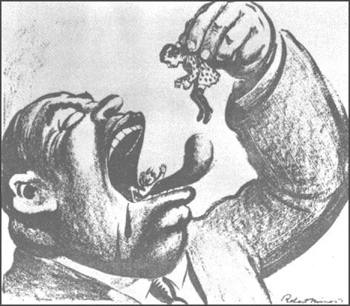

Slide 44
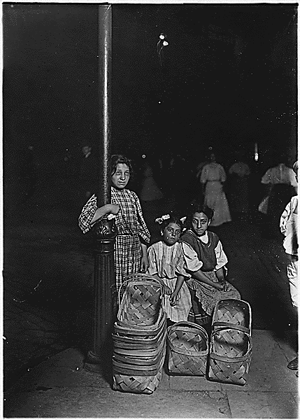
Basket sellers Cincinnati, OH 1908

Slide 45
Teddy Roosevelt & the Square Deal
SWBAT explain TR’s square deal and how it relates to the reforms of the progressive movement.
T.R. loved to lead and to fight those he felt were not acting in America's best interests.

Slide 46
Northern Securities Case
-T.R. used the Sherman Anti-trust Act to attack a railroad monopoly
- Supreme Court ordered the company to dissolve.
-Added Departments of Labor and Commerce to the Cabinet
-Urged Congressional approval of the Pure Food and Drug Act (1906)
--forbade impure foods and required labeling of ingredients for both foods and drugs.
Coal Strike
-coal mine owners refused to deal with the union in a 1902 strike
-T.R. summoned them and the head of the mine workers to the White House
-threatened to use army troops to keep the mines open.
-Owners backed down
-T.R. was credited with ending the strike

Slide 47
Conservation reform added massive areas to the national forests (total of 190 million acres)
Transferred forests to the U.S. Forest Service headed by Gifford Pinchot, who insisted that trees be planted as well as harvested
Withdrew millions of acres of public land from sale to protect resources
Used public land sale revenues to build dams and canal systems

Slide 48
Major Progressivism Programs
Education
1. Progressive education--John Dewey led movement that focused on personal growth, not mastery of body of knowledge. Promoted learning through experience.
2. Charles Eliot of Harvard pioneered elective courses and new teaching techniques (such as seminars) to make university learning more meaningful
3. Women began attending colleges in large numbers (by 1920, 47% of total enrollment was female).
4. Believing that more education would help bring an enlightened population, Progressives pushed enrollments to record levels (86% of children in schools by 1920)

Slide 49
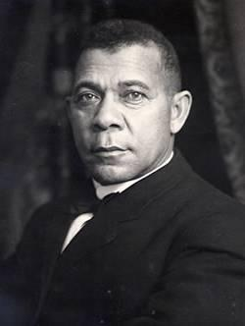
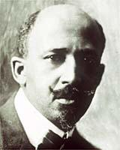
Racial anti-discrimination efforts
Booker T. Washington (Atlanta Compromise) argued for self-help and accommodation on the part of blacks to white society
2. W.E.B. DuBois (Niagara Movement--1905) urged blacks to assert themselves and agitate for political and economic rights. Formed NAACP to use legal means to end racial discrimination

Slide 50
Women's rights
While the number of employed women stayed constant from 1900-1920 (20%), the type of work switched from domestic labor (servants, cooks, laundresses) to clerical work (clerks, typists, bookkeepers), factory work, and professionals.
Most women still held the lowest paying and least opportune jobs
Significant Progressive feminists called for greater reform
a) Charlotte Perkins Gilman attacked the male
monopoly on opportunity and declared that
domesticity was an obsolete value for American
women b) Margaret Sanger led the movement to provide
birth control to prevent unwanted pregnancies
among poor women c) Suffragists urged that women be given the
franchise, which came on the national level with
the 19th Amendment (1919).

Slide 51
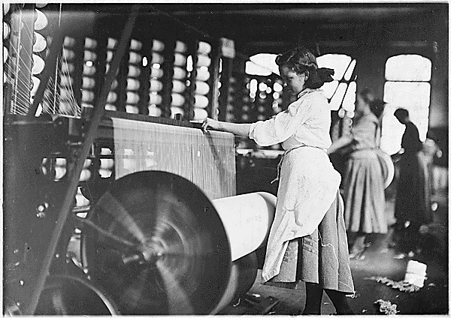
Child labor laws--most states passed minimum working age laws and prohibited children from working more than 10 hours per day, but enforcement was difficult to achieve.

Slide 52
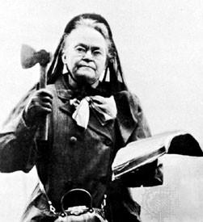
Temperance--Anti-Saloon League and Women's Christian Temperance Union fought alcoholism on the state level through blue laws and on the national level with the 18th Amendment which prohibited the manufacture, sale, and transportation of liquor. Led by Carrie “Hatchet” Nation

Slide 54
Presidential Election of 1912
Republican successor Taft proved to be less progressive than T.R. in the areas of tariff reform and conservation.
Payne-Aldrich Tariff (heralded by Taft as "the best tariff passed by the Republican Party") protected industries and kept consumer prices high
A public land sale scandal in Alaska pitted Pinchot against Secretary of Interior Ballinger. Taft fired Pinchot

Slide 55
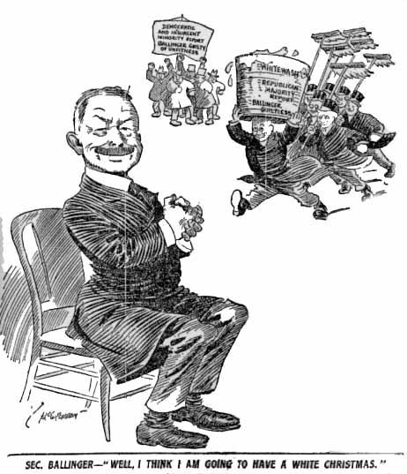
The Ballinger- Pinchot Controversy

Slide 56
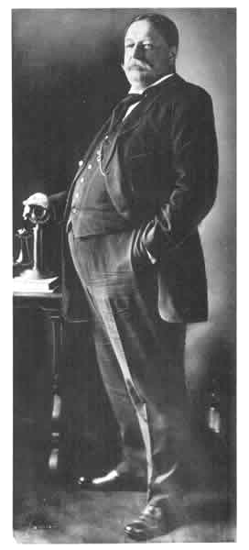
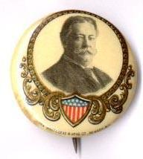
The Republican Party & President William H. Taft

Slide 57
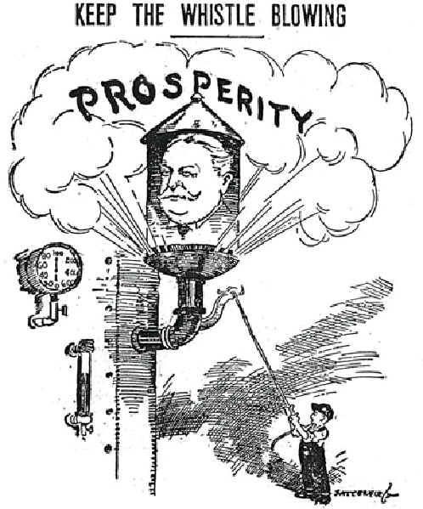
Keep the Whistle Blowing

Slide 58
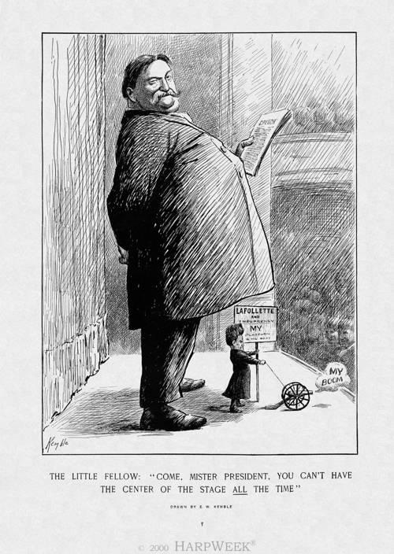
Come, Mr. President. You Can’t Have the Stage ALL of the Time!

Slide 59
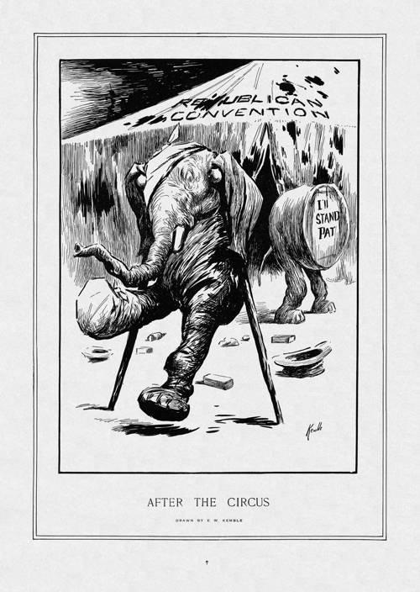
The GOP (Grand Old Party)
After the Circus

Slide 60
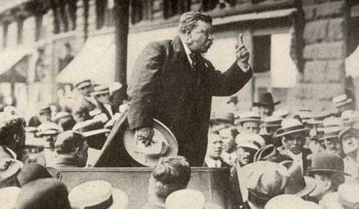
The Progressive Party & Theodore Roosevelt

Slide 61
T.Roosevelt organized the National Progressive or "Bull Moose" Party after Progressive Republicans bolted the Taft-controlled Republican convention.
Party platform included long list of Progressive demands. Effectively split the Republicans into two camps.

Slide 62
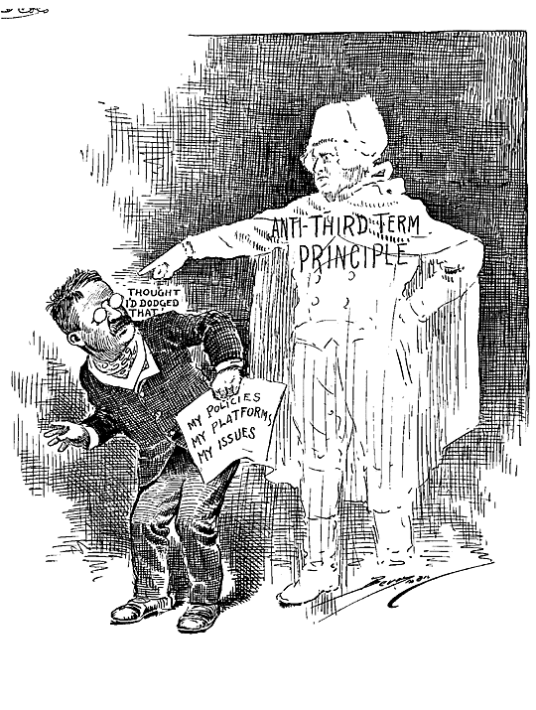
The Anti- Third-Term Principle

Slide 63
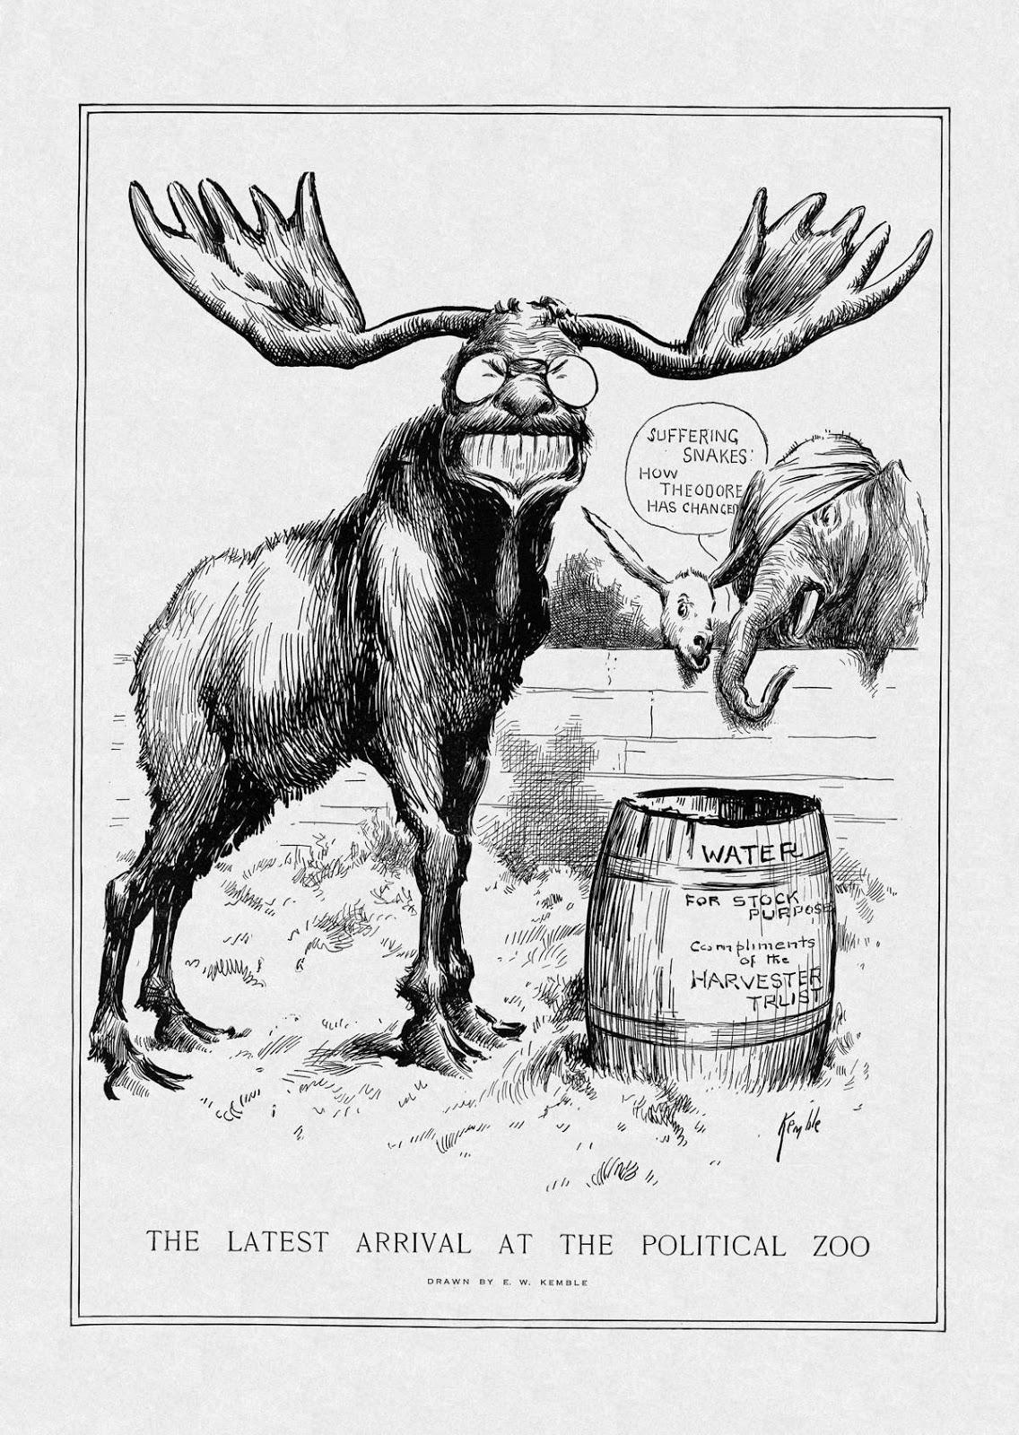
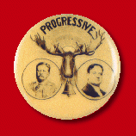
The “Bull Moose” Party:
The Latest Arrival at the Political Zoo

Slide 64
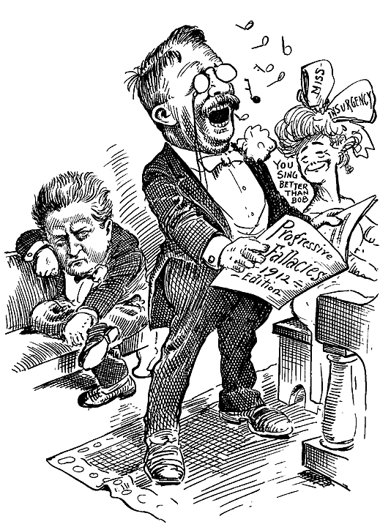
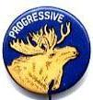
Progressive Fallacies:
1912 Edition

Slide 65
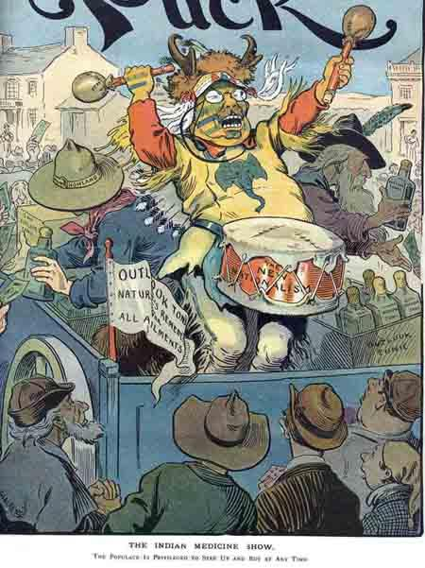
The New Nationalism:
The Indian Medicine Show

Slide 66
Democrats nominated Woodrow Wilson, the scholarly governor of New Jersey who called for moral revival and reform, including low tariffs, the breaking up of all monopolies, and for the government to be an umpire in disputes between labor and business.

Slide 67
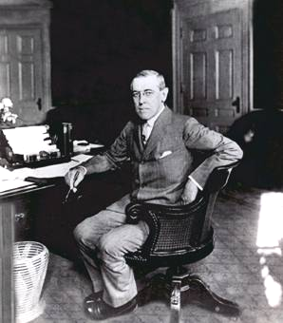
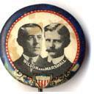
The Democratic Party & Governor Woodrow Wilson (NJ)

Slide 68
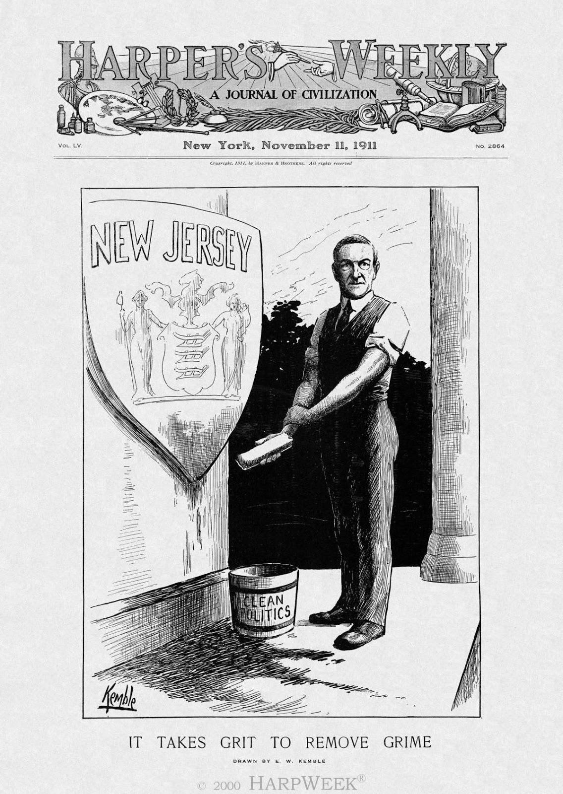
It Takes Time to Remove the Grime

Slide 69
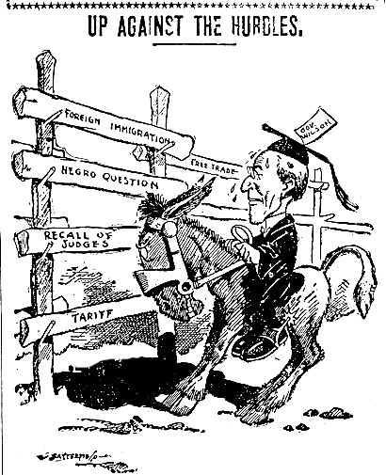
Up Against the Hurdles

Slide 70
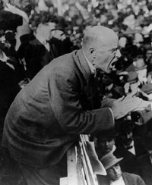
Socialists nominated Eugene Debs, who called for public(government) ownership of all natural resources and major industries.

Slide 71
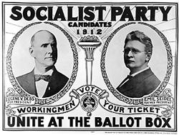
The Socialist Party & Eugene V. Debs

Slide 72
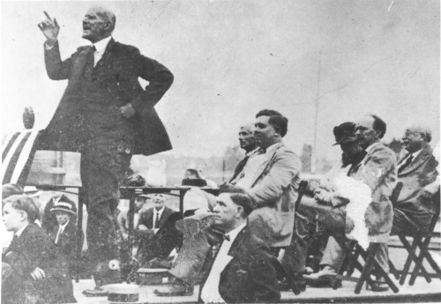
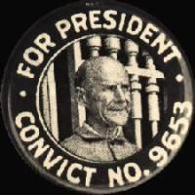
Debs on the Campaign Trail

Slide 73
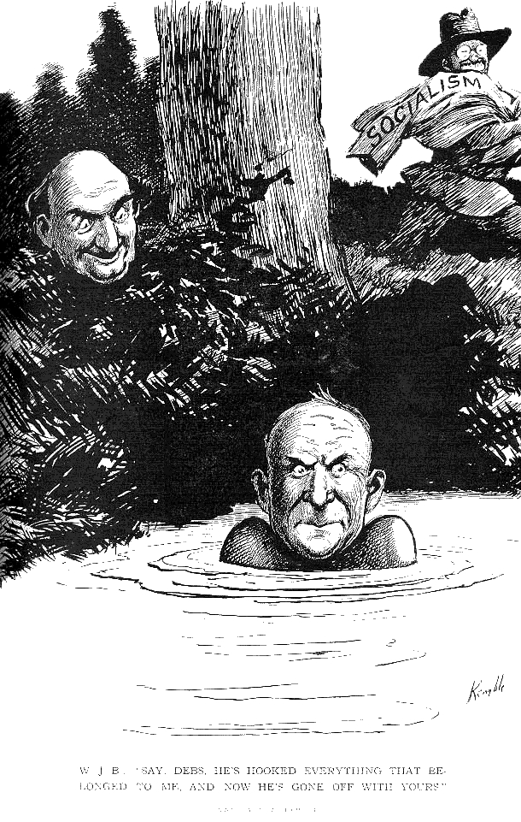
He’s Gone Off With Your Clothes

Slide 74
The Key Issues

Slide 75
The Industrial Worker: I. W. W.

Slide 76
The Unanswerable Argument for Suffrage

Slide 77
Lynching & the Race Issue

Slide 78
Mr. Lewis Gets His Share

Slide 79
The Results

Slide 80
Oh, That This Too, Too Solid, the South Would Melt!

Slide 81
An Actual 1912 Ballot

Slide 82
Election Results

Slide 83
GOP Divided by Bull Moose Equals Democratic Victory!
Wilson won 40 of 48 states as Republicans split between Taft and T.R.

Slide 84
The GOP:
An Extinct Animal?

Slide 85
Wilson's New Freedom and Progressivism
Tariff reform--Underwood Tariff (1913) gave first significant tariff reduction since 1860s as Wilson personally delivered his goals to Congress.
Currency and banking reform-- Creation of Federal Reserve System
1. Acted as bankers' banks and prevented "runs"
on bank assets 2. Federal reserve notes created a flexible new
currency to the banking system
Clayton Antitrust Act (1914) to restrict monopolies and set up a Federal Trade Commission to stop unfair practices which may arise

Slide 86
Evaluation of Progressivism
Weaknesses of Progressive reform
1. Material progress of Americans weakened
zeal of reformers 2. Myriad of Progressive goals were often
confusing and contradictory 3. Opposition to Progressivism apparent as
initiatives failed and courts struck down
Progressive legislation 4. Government remained mainly under the
influence of business and industry 5. Outbreak of World War I dampened enthusiasm
of attempts to use governments to create just
societies on earth

Slide 87
Progressive accomplishments
1. Trust busting forced industrialists to
notice public opinion 2. Legislation gave federal and state
governments the tools to protect consumers. 3. Income tax helped build government revenues
and redistribute wealth 4. Progressives successfully challenged
traditional institutions and approaches to
domestic problems.

Slide 88
TAFT & WILSON SWBAT1. Summarize the events of the Taft Administration 2. Describe the election of 19123. Describe Woodrow Wilson’s background and the Progressive Reforms of his presidency.

Slide 89
WILLIAM HOWARD TAFT
After winning the election in 1904 Teddy Roosevelt pledged not to run in 1908. Taft, previously the Secretary of War, was TR’s hand picked successor as President
Taft’s cautious nature made it impossible for him to hold together the two wings of the Republican Party
As a result, the Republican Party split and TR formed the third party Progressive Party which became known as the Bull Moose party.
This split allows Wilson to win the Presidency in 1912.

Slide 90
WILLIAM HOWARD TAFT’S DOMESTIC POLICY

Slide 91
TRUST BUSTING
More than twice the number of antitrust suits filed than under Roosevelt.
Major victories were won against Standard Oil of New Jersey and the American Tobacco Company (both initiated under T.R.), the Sugar Trust and U.S. Steel.
Roosevelt was generally supportive of these Taft actions, but not the move against Morgan and U.S. Steel
The former president criticized his successor by proclaiming that Taft was unable to distinguish between a good trust and a bad one.

Slide 92
Tariffs
tariff -a tax on imported items used to protect U.S. business.
E.g. A tariff on steel imported from England, makes English steel more expensive, therefore encouraging consumers to buy U.S. made steel.

Slide 93
TARIFFS
Taft pledged tariff reform during the campaign of 1908 and appeared initially to pursue that goal.
Result was not the major change reformers had hoped for but the mildly protectionist
PAYNE-ALDRICH TARIFF:
lowered the general tariff rate from 46 to 41 percent
increased rates on items such as animal hides, iron ore and coal
lowered 650 tariff items, raised 220 and left 1,150 untouched

Slide 94
MANN-ELKINS ACT 1910
Taft was successful in urging Congress to strengthen the powers of the Interstate Commerce Commission.
The Mann-Elkins Act 1910 provided:
The I.C.C. was empowered to suspend or fix railroad rates
The purview of the I.C.C. was extended to include control of radio, telephone and telegraph facilities
This measure made the Interstate Commerce Commission the most influential agency of its day

Slide 95
ELECTION OF 1912
TR, candidate for the Progressive Party, split the Republican vote, denying the election to the incumbent Taft and awarding it to Democrat Woodrow Wilson

Slide 96
WOODROW WILSON’S DOMESTIC POLICY

Slide 97
WOODROW WILSON
Woodrow Wilson was a political science professor from Princeton who had been governor of New Jersey but came from a southern background
Within the first 100 days, guides a series of measures through Congress that become known as the New Freedom policy
Seeks to regulate industry for good of the nation
Re-enforced power of the Presidency while helping the working class

Slide 98
“NEW FREEDOM”
UNDERWOOD TARIFF (1913)—drastically reduced tariff schedules and transferred many articles to the free list
FEDERAL TRADE COMMISSION (1914)— investigate and expose unfair practices in corporations
CLAYTON ANTI-TRUST ACT—further curbed the strength of big corporations by making certain business practices illegal such as price discrimination and the handling of competitor's products

Slide 99
“NEW FREEDOM”
LA FOLLETTE SEAMEN’S ACT (1915)— regulated labor conditions aboard ship
ADAMSON ACT (1916)—established an eight-hour day for railroad employees
FEDERAL FARM LOAN ACT (1916)—provided for loans to cooperative farm associations

Slide 100
FEDERAL RESERVE SYSTEM
FEDERAL RESERVE SYSTEM (1913, start operation November 1914)—gave the nation a central banking system for the first time since Andrew Jackson
The bank was extremely effective in keeping money within the economy despite bad or good times

